Slide 1



AIRBNB IN PARIS
FELICIA ONWUDINJO
JUN, 10th | PARIS
DAFT MAY2022

Slide 2


Business case
Domain: RENTAL MARKET
Problem: Paris is one of the world's most popular tourist destinations, Airbnb rentals are in high demand. Tourists have a hard time deciding which parts of Paris to rent for a reasonable price during their trip. Aside from the rental itself, one must hunt for rentals with positive reviews and check the availability of Airbnb properties during specific times of the year. In this project, we will look into some of these challenges.
Notes:
ffffgg

Slide 3
Plan
In this project, we intend to go through the data cleansing process in order to prepare our dataset for solving our business problems. Following that, we examined our data in order to respond and solve crucial questions. We went over the following procedures:
Detecting null values
Searching for duplications
Looked at outliers which could drastically change the mean of our dataset.

Slide 4
About data
The datasets consists of information about Airbnb listings in Paris city. Since 2008, guests and hosts have used Airbnb to travel in a more unique, personalized way. As part of the Airbnb Inside initiative, this dataset describes the listing activity of homestays in Paris. An initial part of the examination of the data is performed. The data comprises 59881 rows and 96 columns.
The data is gotten from the following link: https://www.kaggle.com/datasets/juliatb/airbnb-paris

Slide 5
Data cleaning, Data preparation
We cleaned our data using the following step:
Data Exploration
Data types
Dropping unnecessary columns
Checking for unique values
Checking for null values
Changing name format

Slide 6
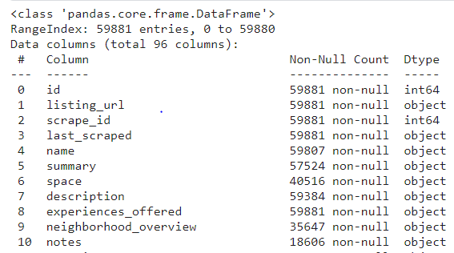
Data Exploration
We explore our data to see and understand what it looks like.
We can see that we have 59881 rows and 96 columns.
From see we have missing data and also see the different data types

Slide 7
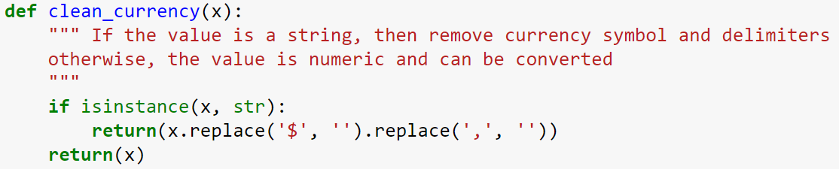
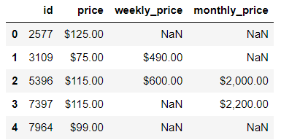
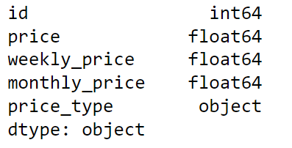
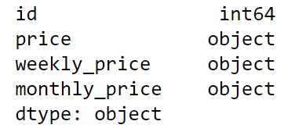
Data types
Results
We realised that the prices columns are object types instead of integer or float, so we had to change this using some codes in python:

Slide 8
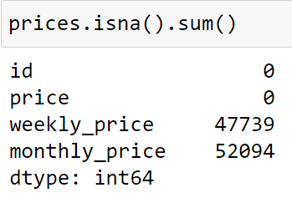
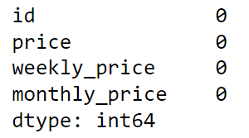
Null values
Next we still look at the prices column and we see that there are lots of null values in both the monthly price columns and weekly price columns, so we fill this by
Multiplying the daily price by 7 to fill up the weekly price missing column.
Multiplying the price by night by 365/12.

Slide 9
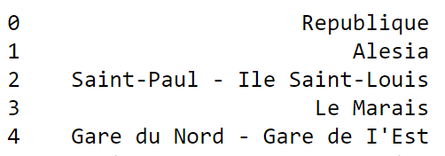
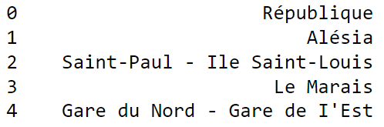
Changing name format
We also realised that from the neighbourhood columns and host location columns, the alphabets are in French language's

Slide 10
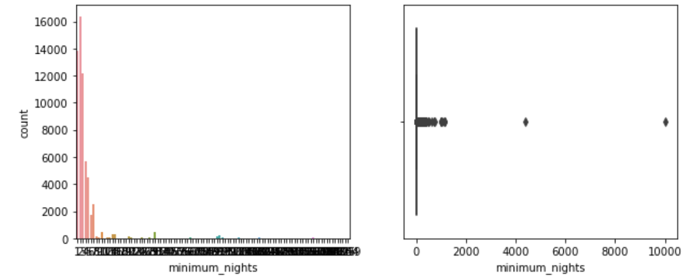
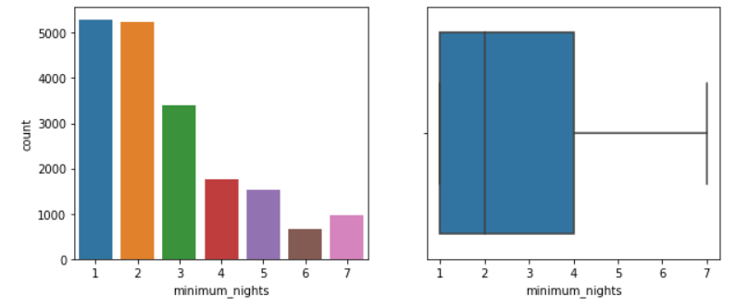
Removing outliers
Here we used boxplots and histograms to visualize outliers.

Slide 11
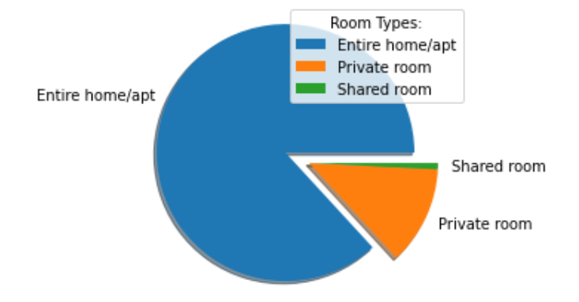
EDA: Distinct room types
We would like to know the type of room with the highest number of listing.
The above shows pie that show that there are more listings for Entire home/apt than Private room, and private room.

Slide 12
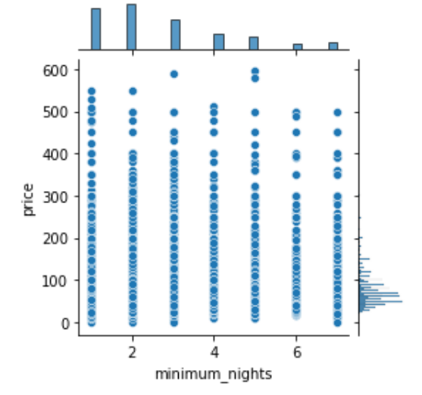
EDA: Relationship between prices and minimum nights
We would like to get the relationship between minimum nights and price
It seems that extreme high priced listings tend to ask for a smaller minimum nights of stay

Slide 13
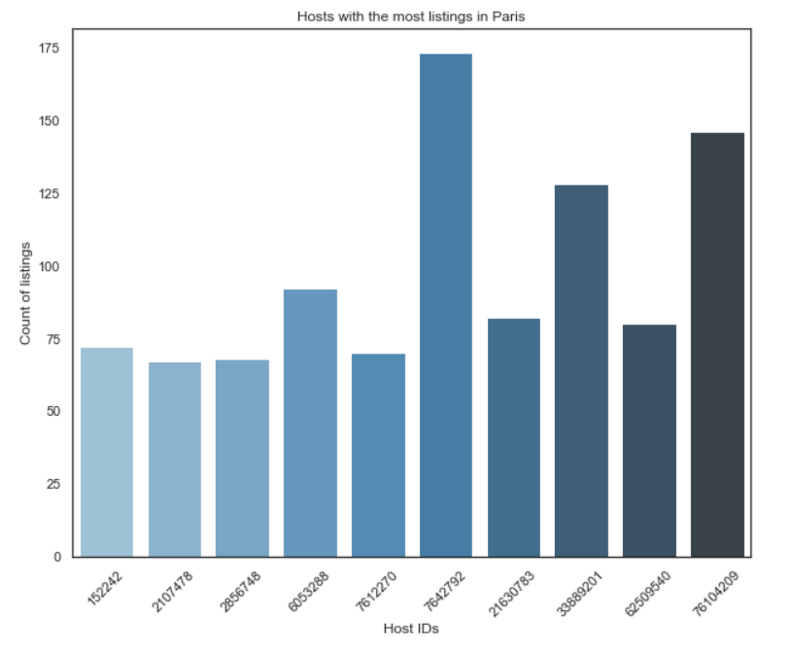
EDA: ID’s with most listings
let's see what hosts (IDs) have the most listings on Airbnb platform and taking advantage of this service
We can see that the host with id number.
7642792 has the highest listing of 173 in
Paris

Slide 14
Choose a data base
In this project we will use the Relational Database because of the following reasons:
It is SQL based and takes CSV files can be connected by keys
We can use SQL like languages to query files
The allow the indexing of columns for faster keys
It supports the join operations.
As compared to NoSQL which is not structured, Relational database is structured into row and columns.

Slide 15
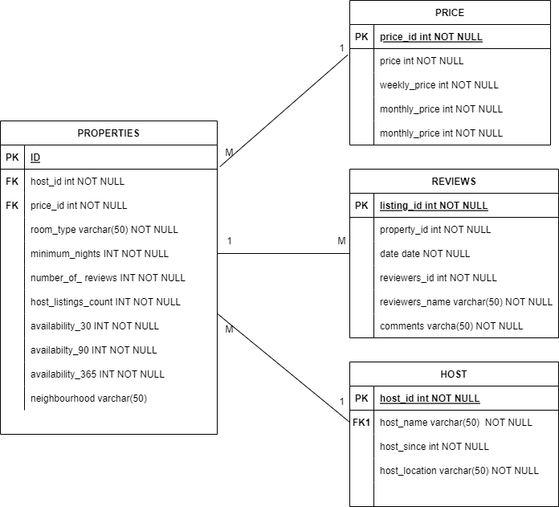
UML Diagram
PK represents Primary keys
FK represents Foreign keys
INT represents integer
VARCHAR represents variable character.

Slide 16
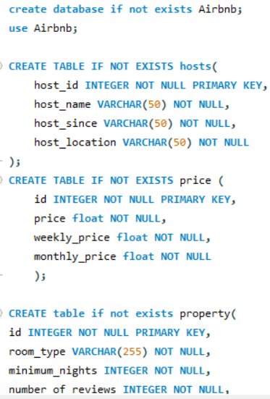
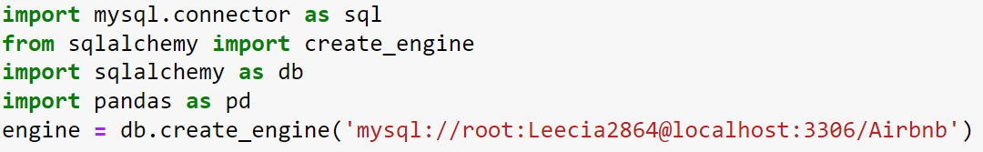

Database creation and insertion
We created a database in MySQL called Airbnb and also created tables with identifiers such as the primary and the foreign keys:

Slide 17

SQL Queries
How does the average price of an Airbnb listing, per month, compare to the private rental market?
SELECT round(avg(monthly_price),2) as Average_price_per_month
FROM prices;

Slide 18
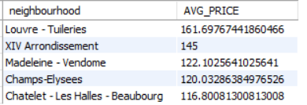

SQL QUERIES
How does the average price of an Airbnb listing, per month, compare to the private rental market?
SELECT round(avg(monthly_price),2) as Average_price_per_month FROM prices;
Next, we would like to know the average price of the most expensive Airbnb properties in Paris.

Slide 19
Conclusions
From these project, we have seen several ways of cleaning data, by
Checking for outliers
Checking for unique values to avoid duplicates
Changing datatypes, fixing alphabetical characters and lots more.
We have shown why we chose the relational database and its advantages
Showed how we created tables and imported our csv files into MySQL
Lastly , We did some queries and gave some data driven insights based on our cleaned dataset.
Notes:
fjrj

Slide 20
Airbnb in Paris
Questions?
Felicia Onwudinjo

